Slide 1
image segmentation
patrick kevorkian

Slide 2
topics
Bi-level thresholding
Multi-level thresholding
Histogram Based Segmentation
Local Adaptive thresholding
Niblack’s Locally Adaptive Thresholding
Sauvola’s Locally Adaptive Thresholding

Slide 3
Bi-Level
One Threshold
Two regions (black & white)
New pixel value determined on if its greater or less than the threshold
Too high, white will obscure image
Too low, black will obscure image
Has issues with uneven illumination

Slide 4
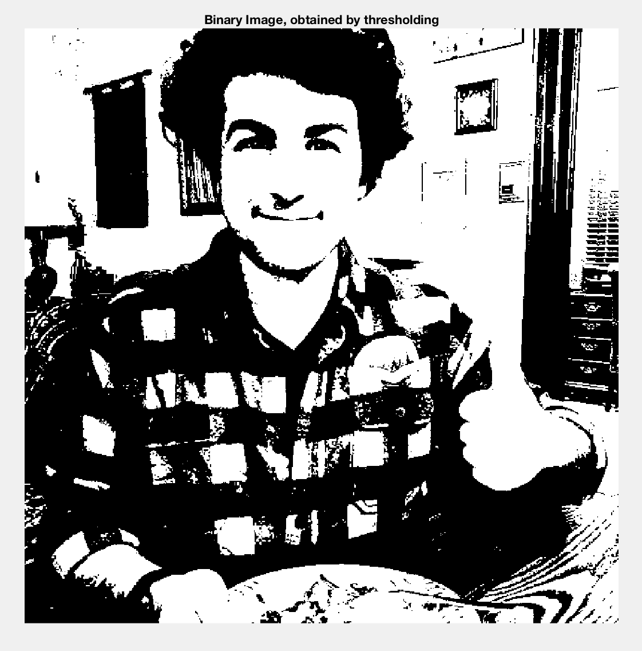
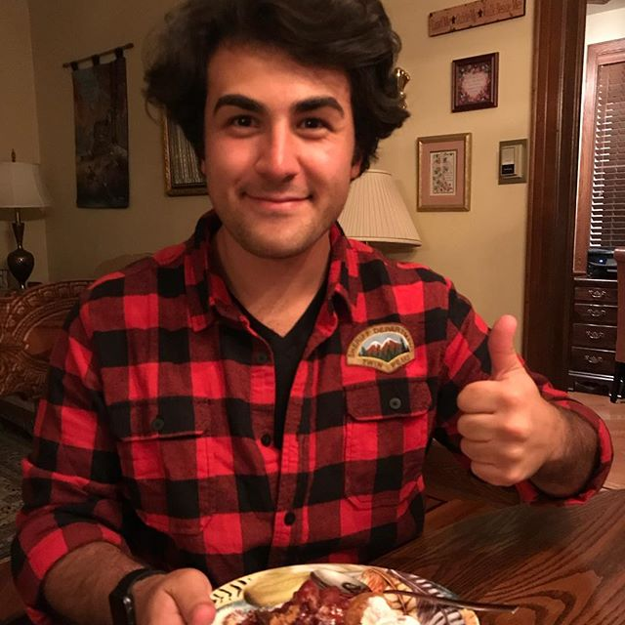
Example 1
thresh = 55

Slide 5
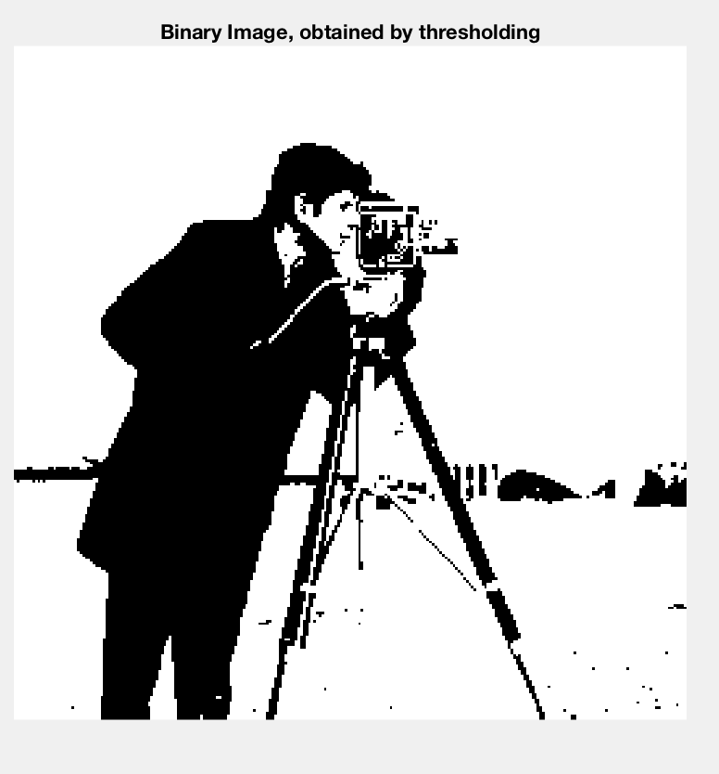

Example 2
thresh = 75

Slide 6
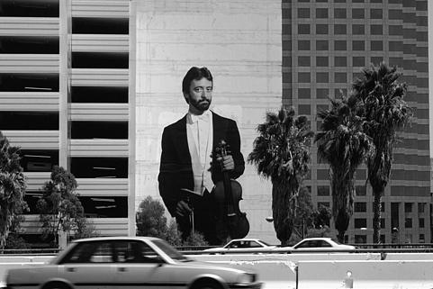
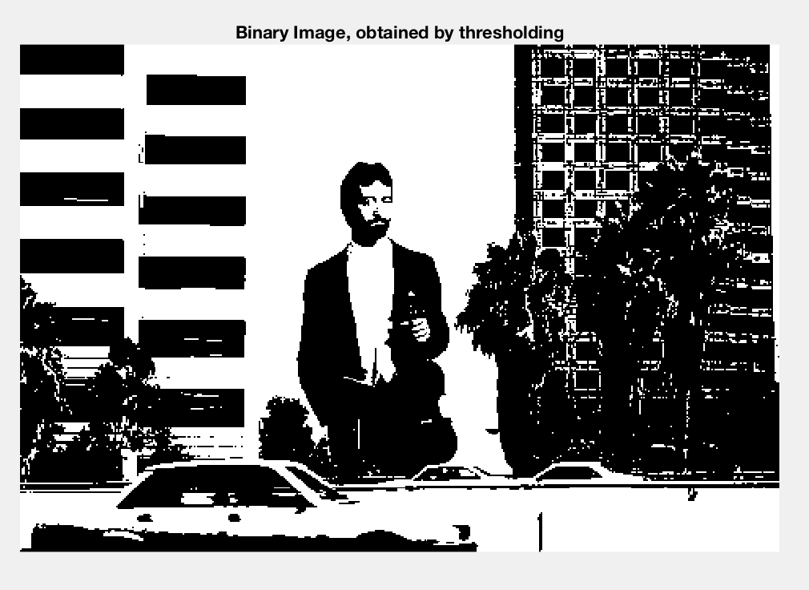
Example 3
Thresh = 100

Slide 7
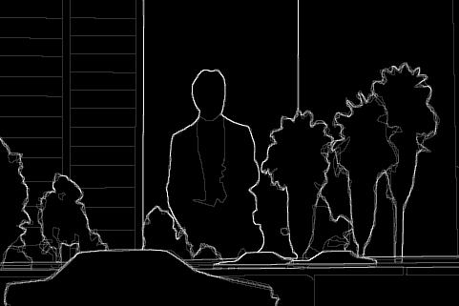
Example 3 Berkley results

Slide 8
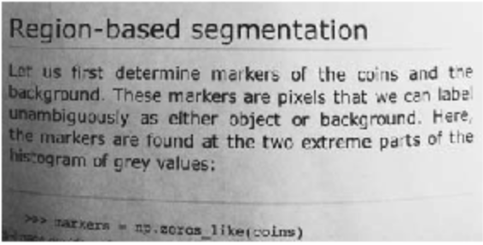
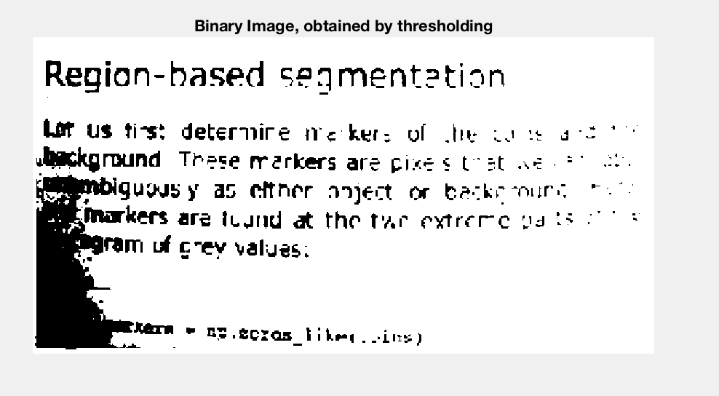
Example 4
thresh =100

Slide 9
Multi-level
Multiple thresholds
Segmentation done with levels of gray
New pixel value determined by where it sits in between, below, and above thresholds
Examples using 2 thresholds for total of 3 levels
Does better with detail and levels of illumination

Slide 10
Histogram
Use histogram peaks of original image to determine thresholds
Makes segmentation a bit easier
But it is difficult to determine number of three olds automatically
Once again for our examples we are using 2
Following Multi level segmentation was done with Histogram

Slide 11
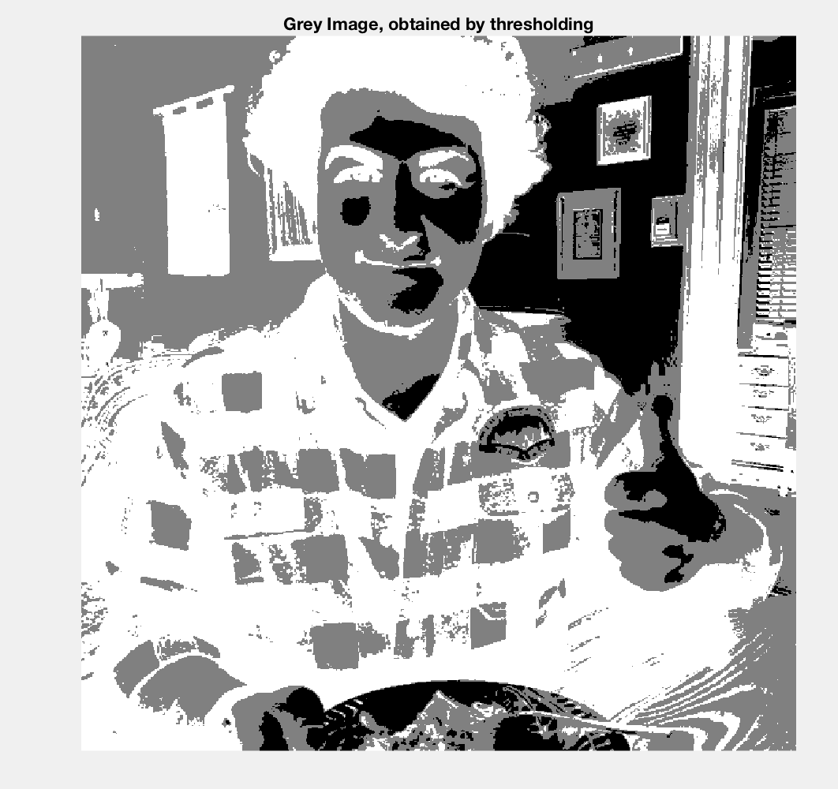
Example 1
thresh = 50,130

Slide 12
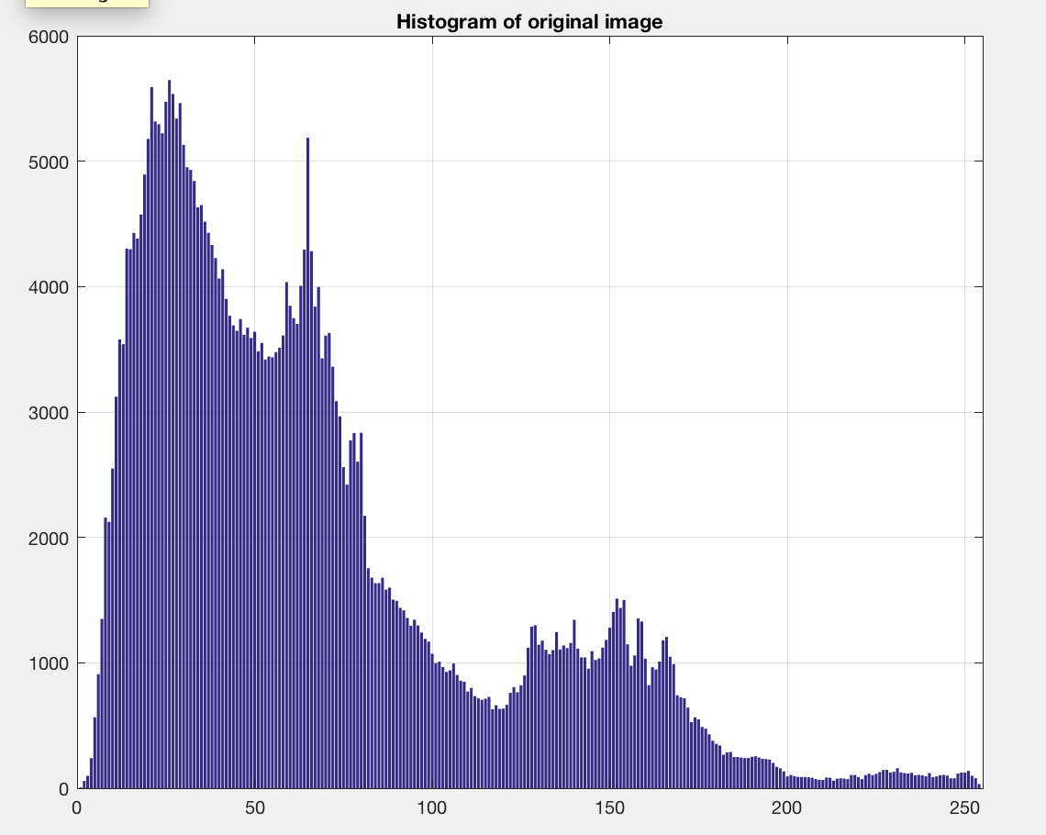
Ex 1 Histogram

Slide 13
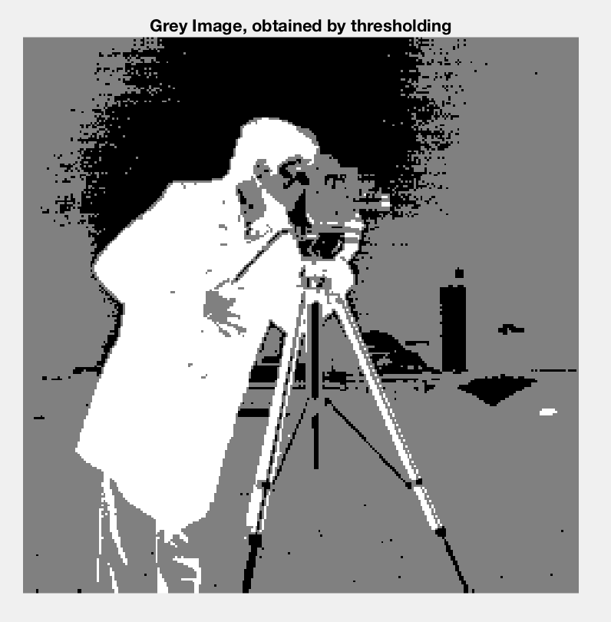
Example 2
Thresh = 20, 170

Slide 14
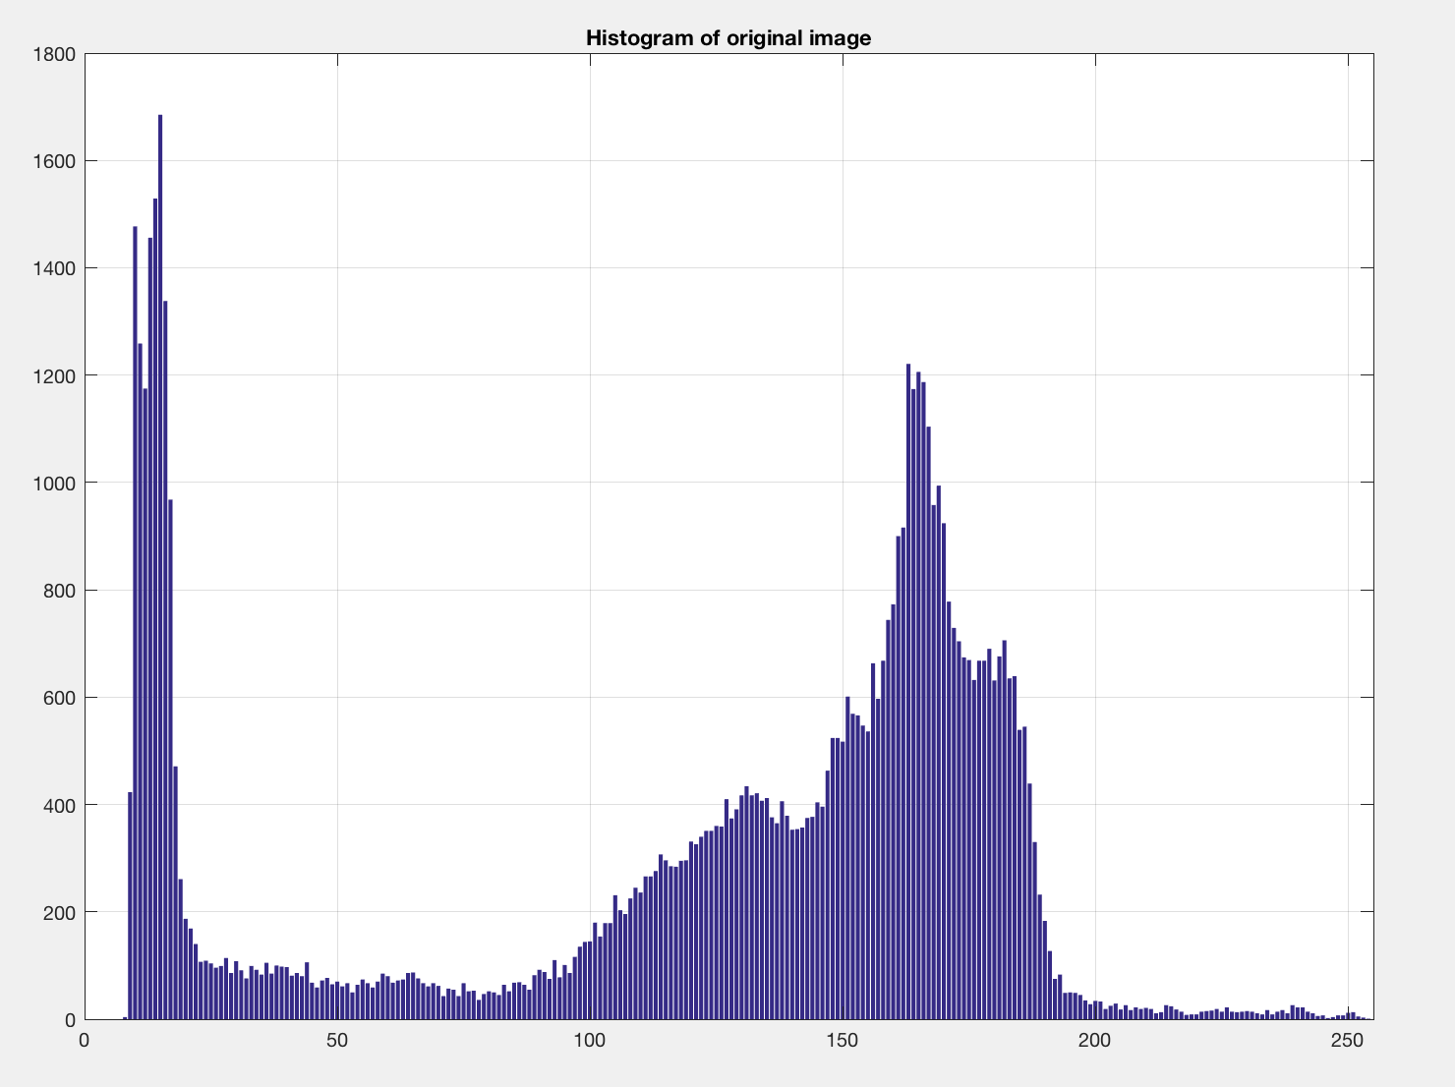
Ex 2 Histogram

Slide 15
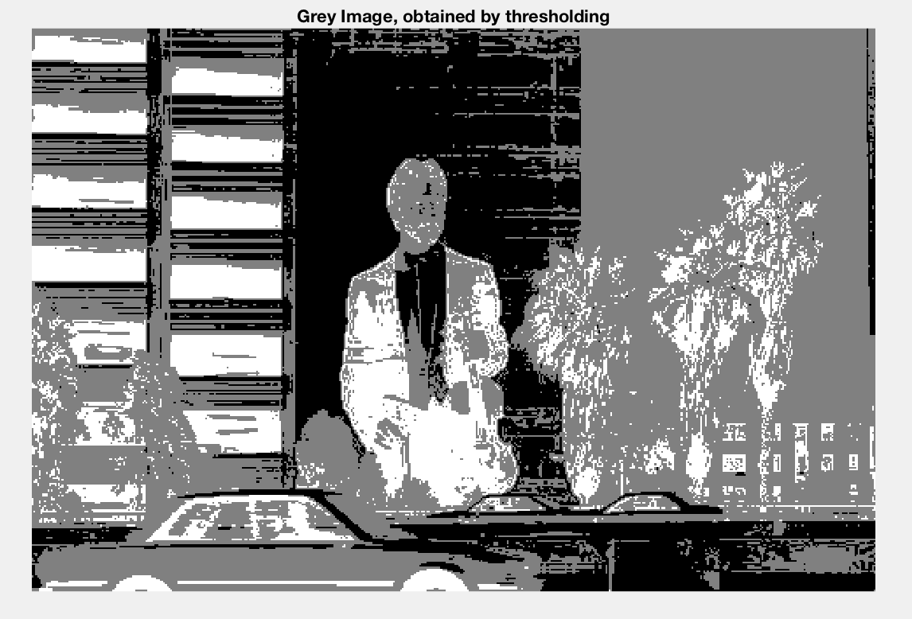
Example 3
Thresh = 20,175

Slide 16
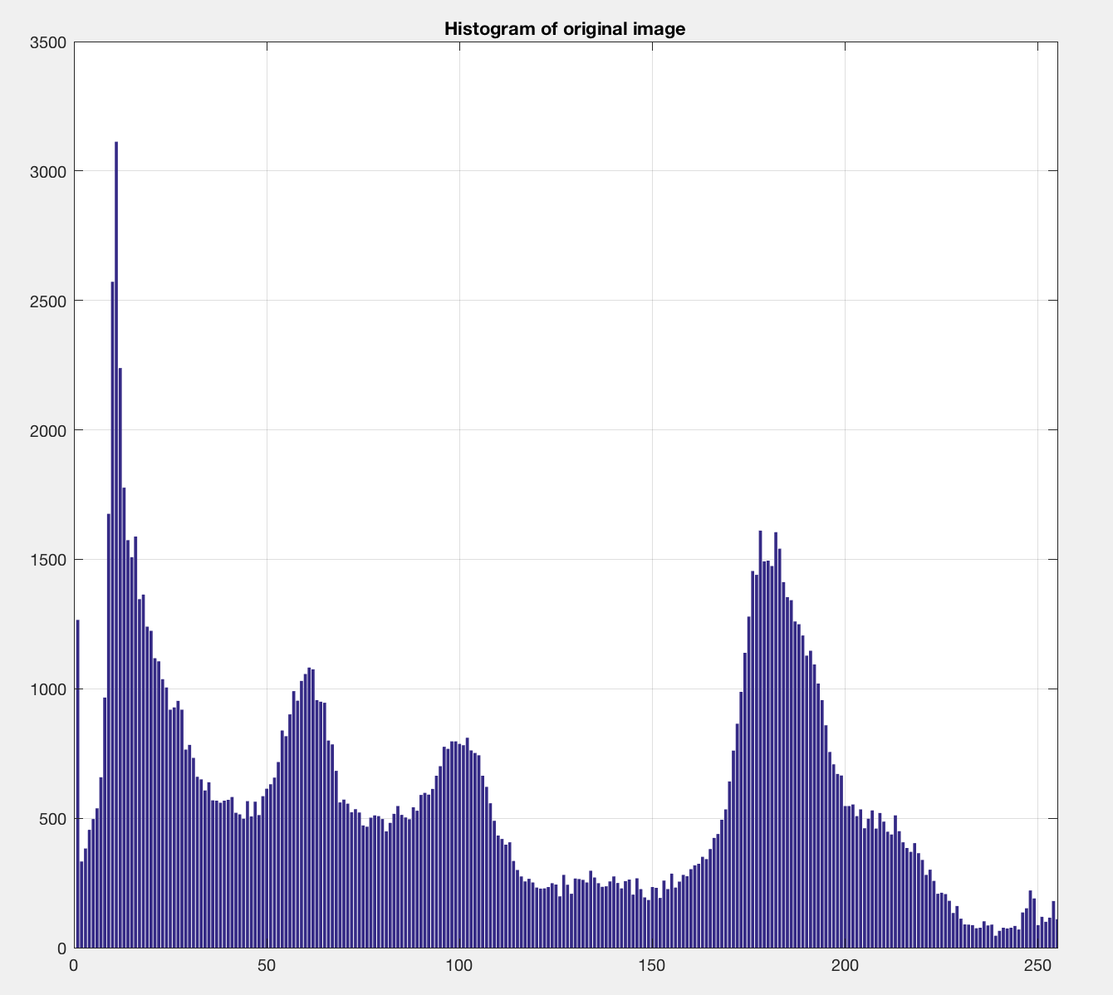
Ex 3 Histogram

Slide 17
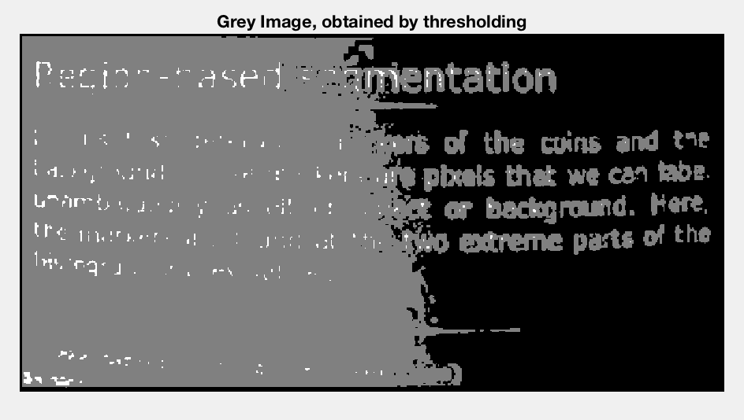
Example 4
Thresh = 50, 200

Slide 18
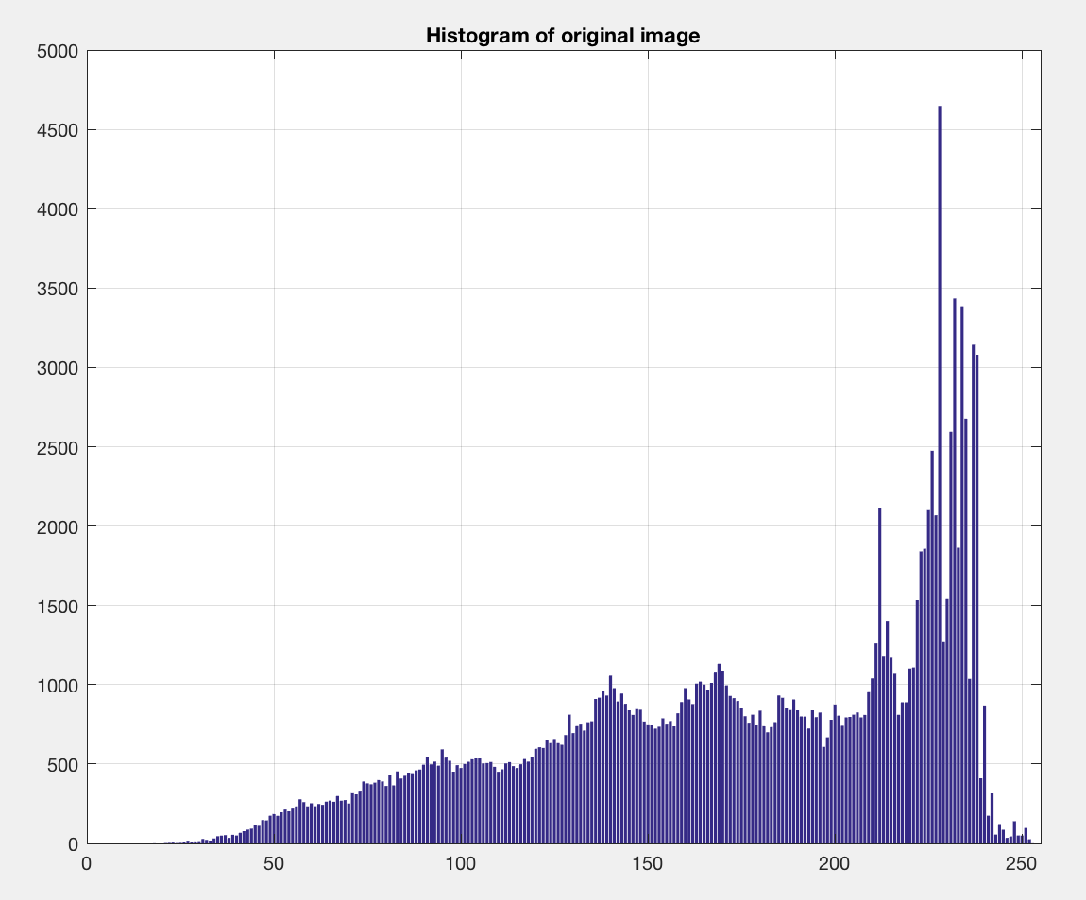
Ex 4 Histogram

Slide 19
Local Adaptive Thresholding
Sliding window approach
Uniform areas are classified as foreground or background
Non-uniform areas we apply a thresholding method
Is able to better overcome illumination variances
But success is not always guaranteed

Slide 20
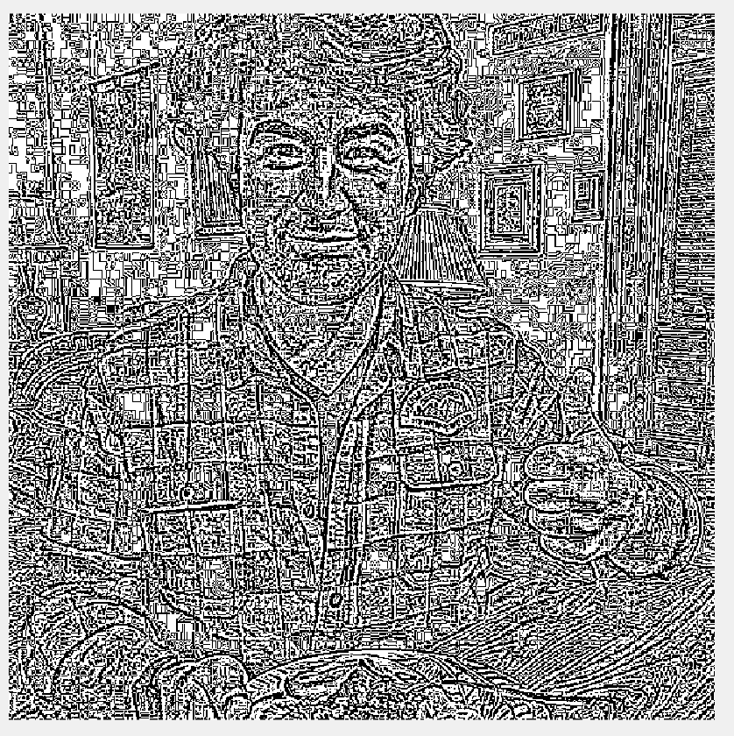
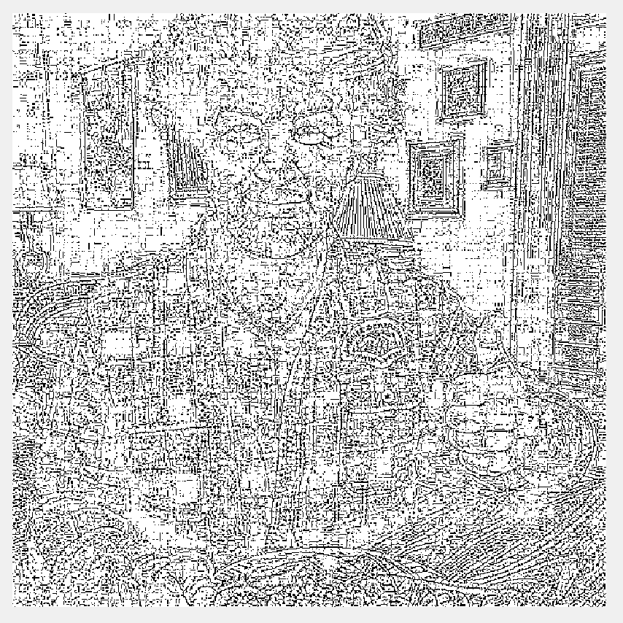
Example 1
default: 3x3, 0
default mean
default median

Slide 21
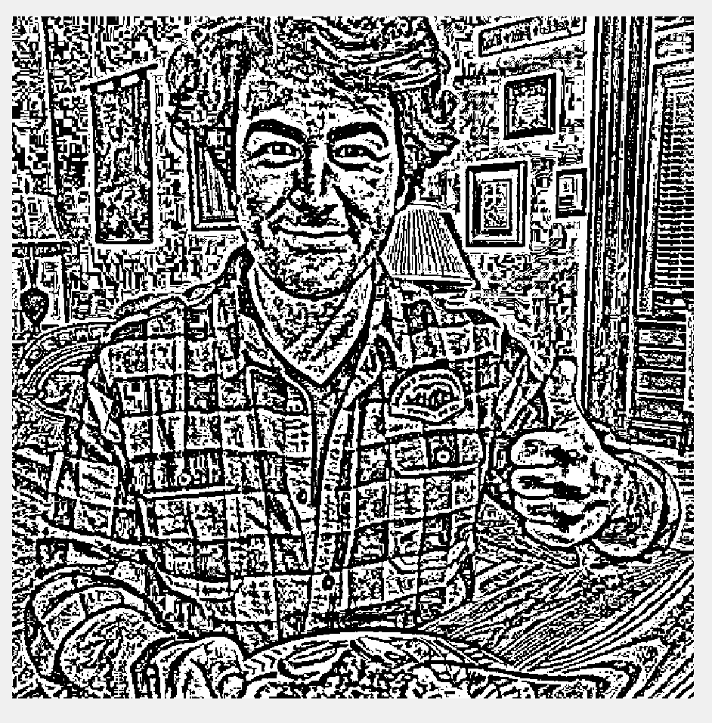
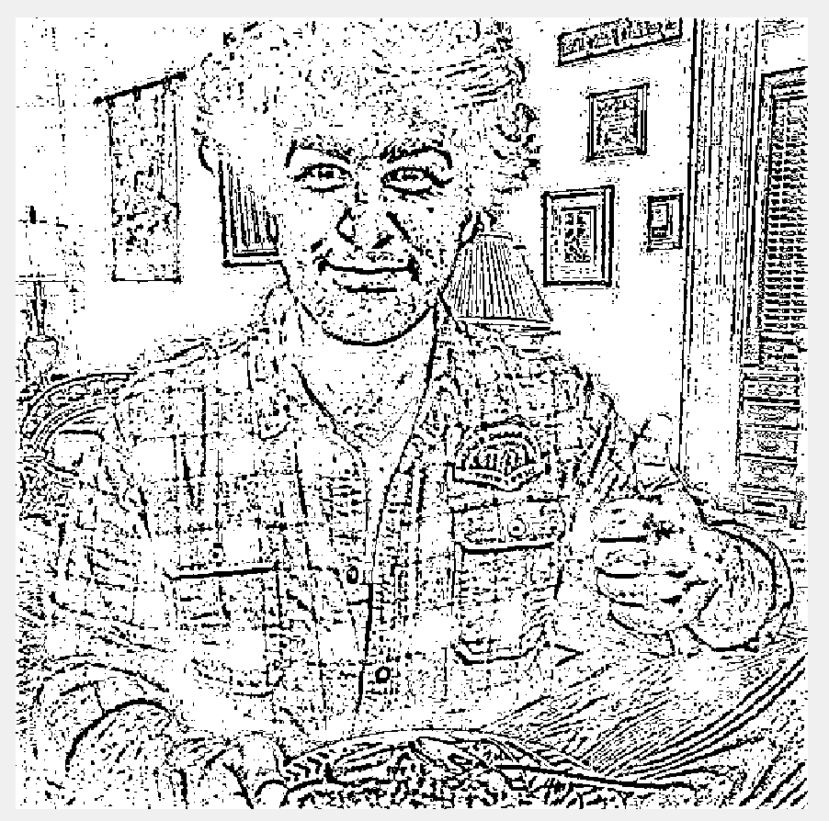
Example 1
“playing” for better results:
Mean: 9x9, 0.11
Median: 9x9, 0.30

Slide 22
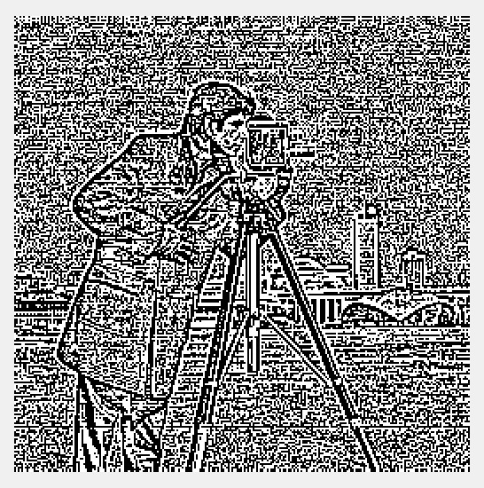
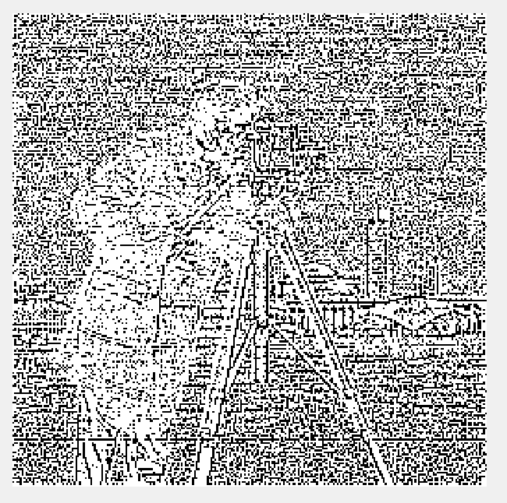
example 2
default: 3x3, 0
default mean
default median

Slide 23
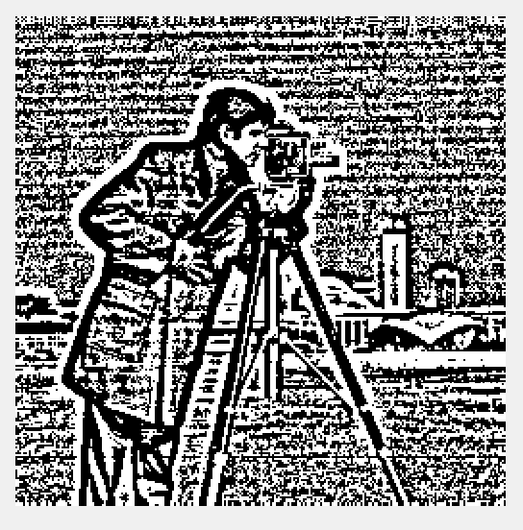
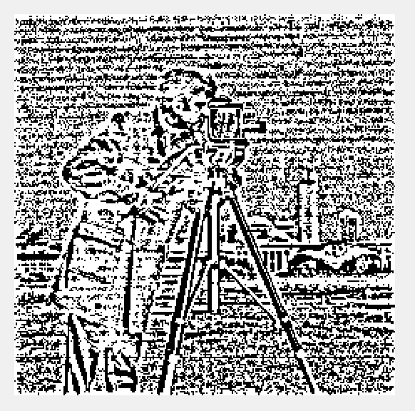
example 2
“playing” for better results:
Mean: 9x9, 0.32
Median: 9x9, 0.20

Slide 24
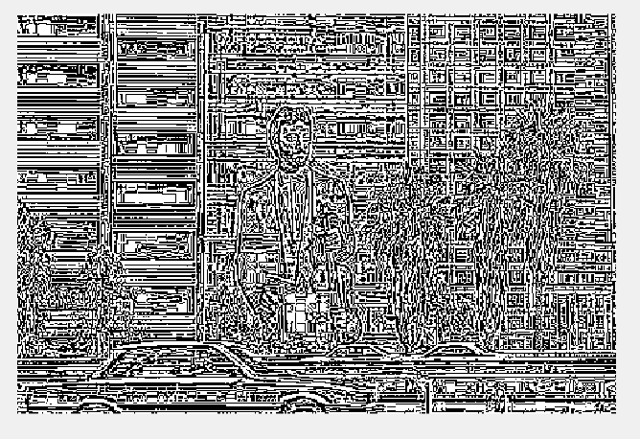
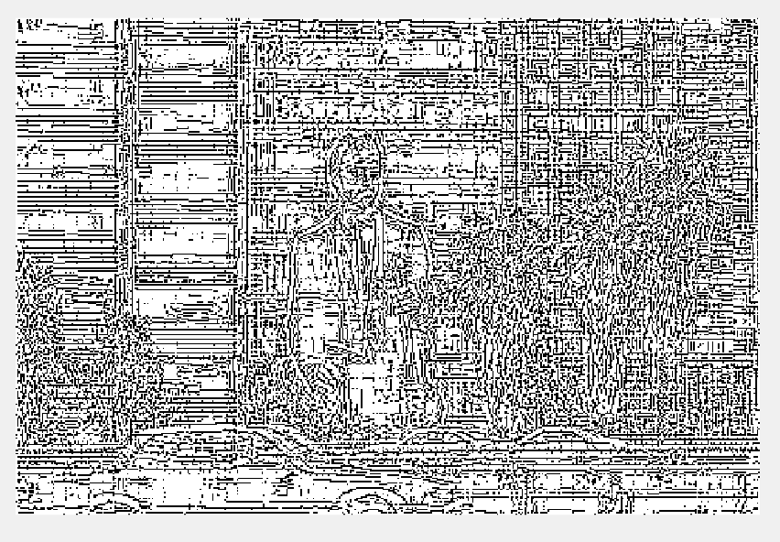
example 3
default: 3x3, 0
default mean
default median

Slide 25
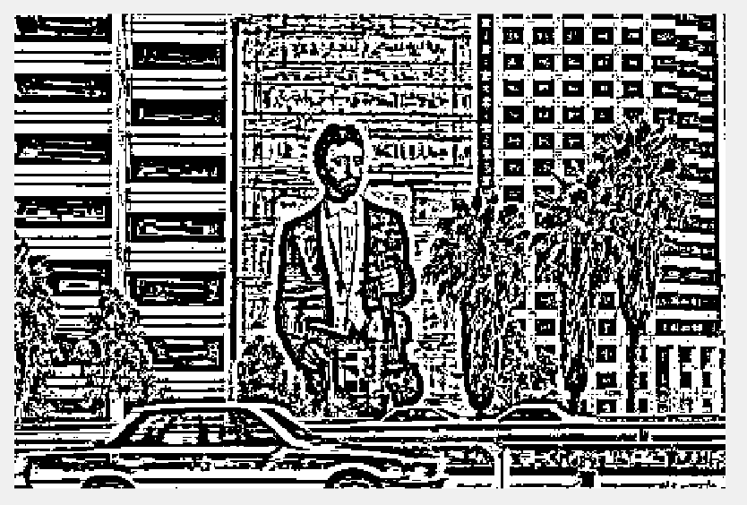
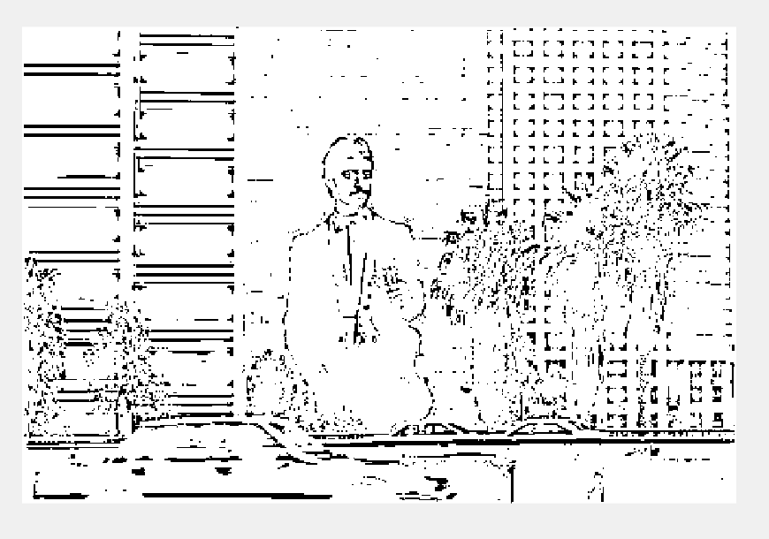
example 3
“playing” for better results:
Mean: 9x9, 0.50
Median: 9x9, 0.7

Slide 26
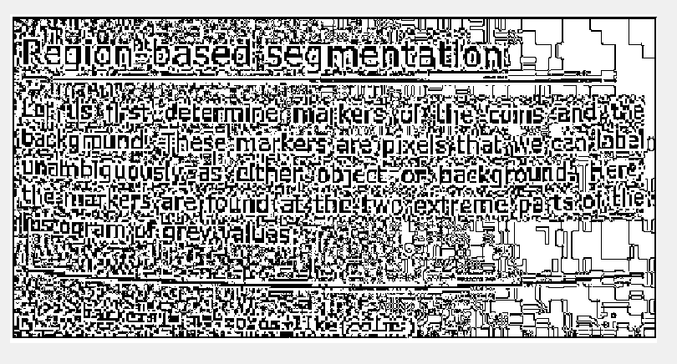
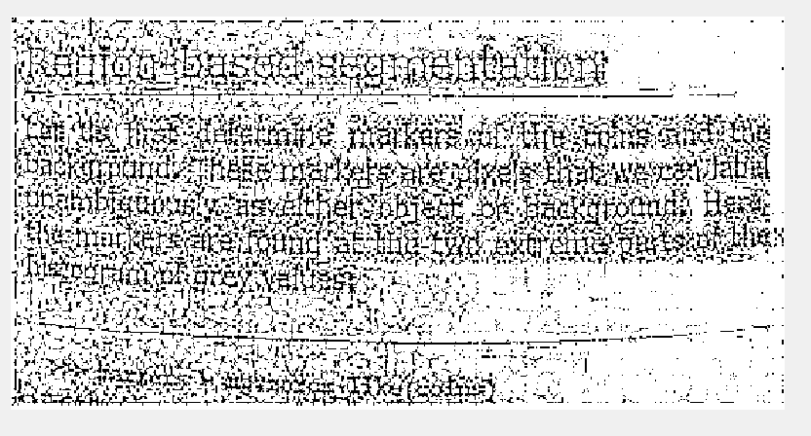
example 4
default: 3x3, 0
default mean
default median

Slide 27
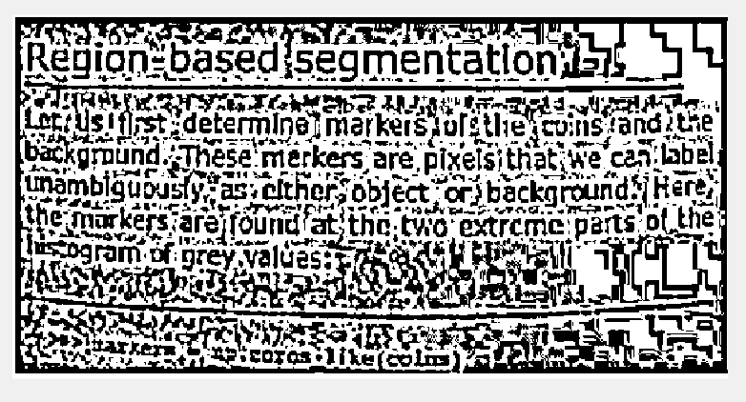
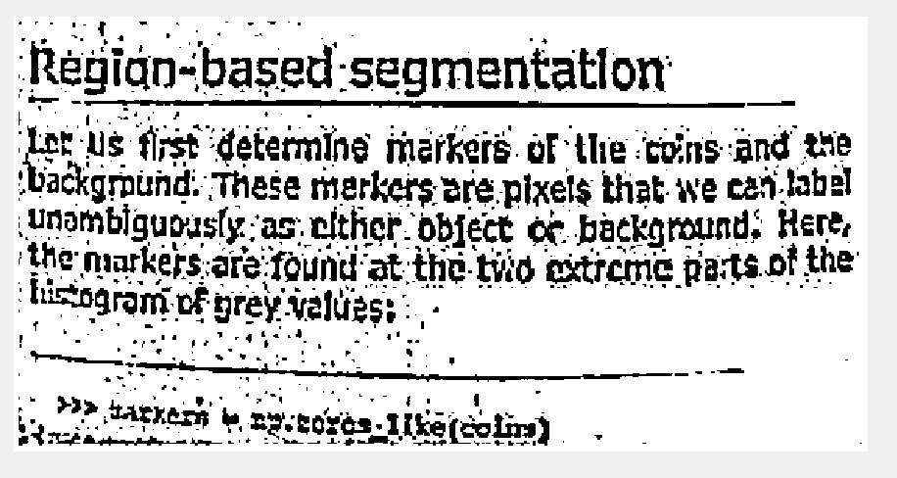
example
“playing” for better results:
Mean: 9x9, 0.14
Median: 9x9, 0.2

Slide 28
Niblack’s Locally Adaptive Thresholding
Window size, to split image into local windows
Threshold of local threshold based on local mean and standard deviation
Default constant “k” is suggested as -0.2
Does not do well with large variance in illumination
Optimum “k” hard to achieve
Following images done with MEAN and MEDIAN

Slide 29
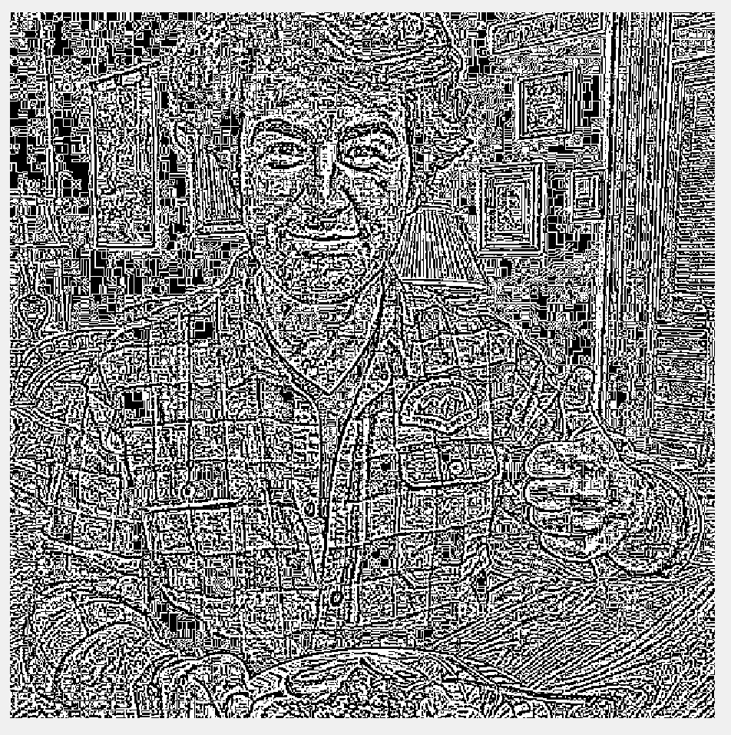
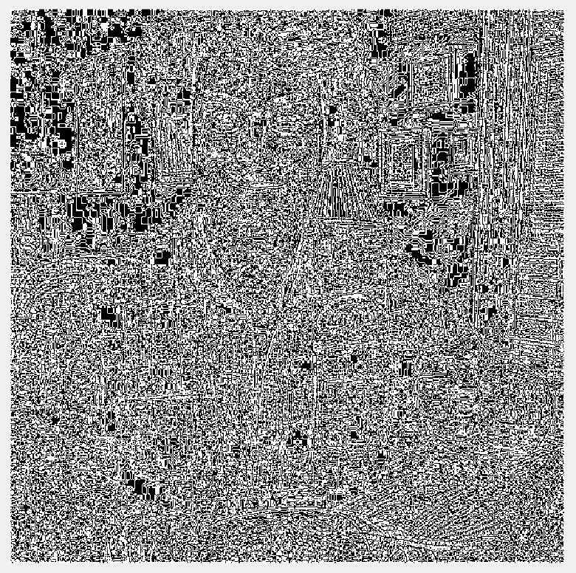
Example 1
default: 3x3, -0.2
default mean
default median

Slide 30
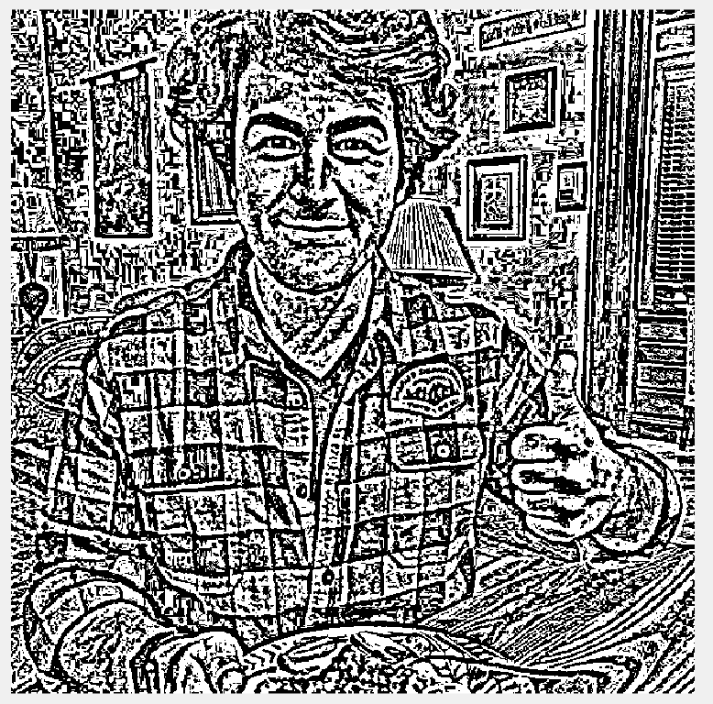
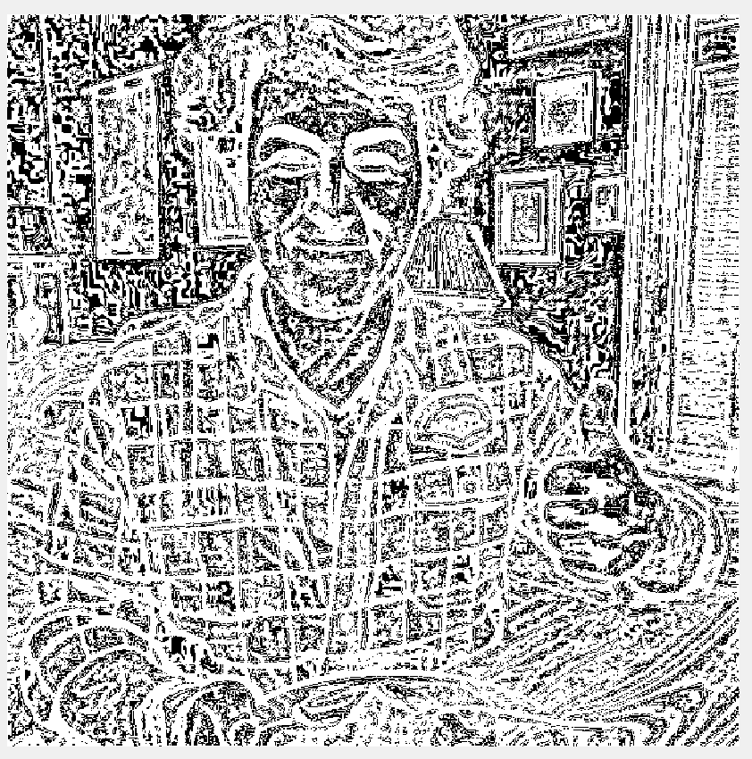
Example 1
“playing” for better results:
Mean: 9x9, -0.2
median: 9x9, -0.99

Slide 31
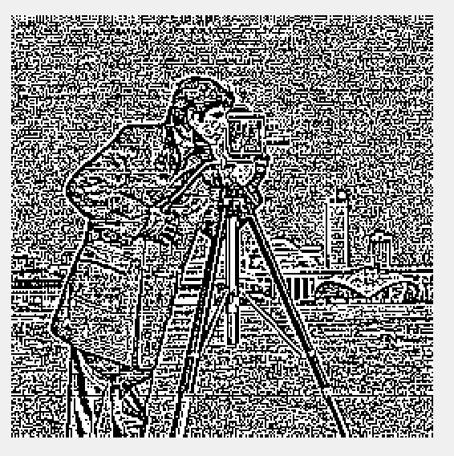
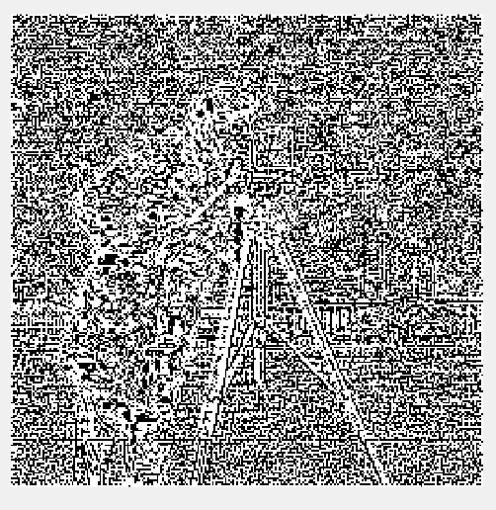
Example 2
default: 3x3, -0.2
Default Mean
default median

Slide 32
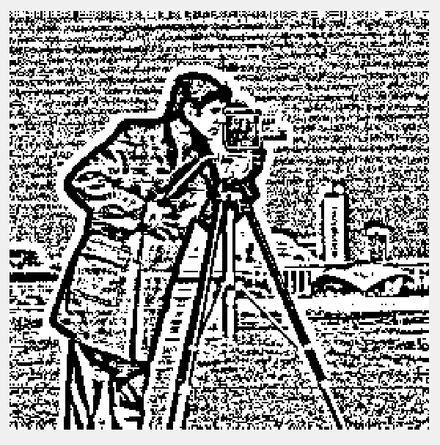
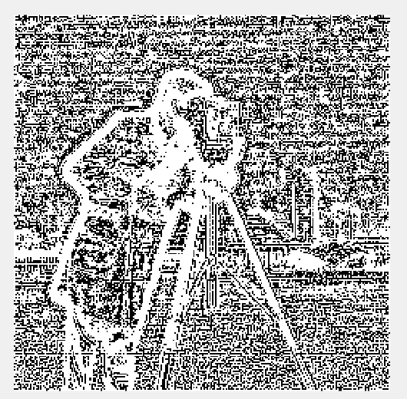
Example 2
“playing” for better results:
Mean: 9x9, -0.2
median: 9x9, -0.9

Slide 33
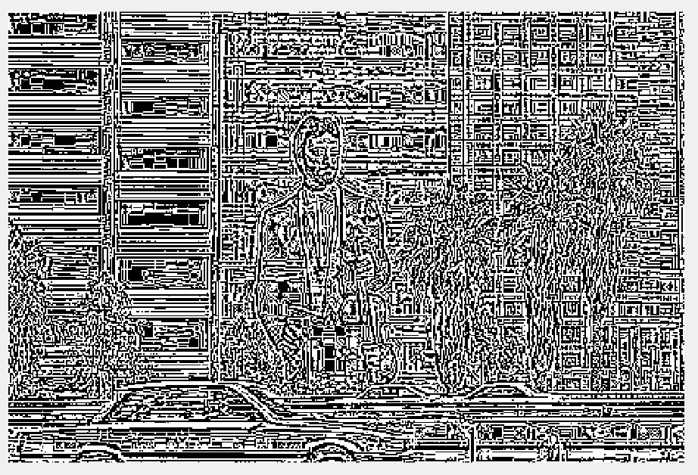
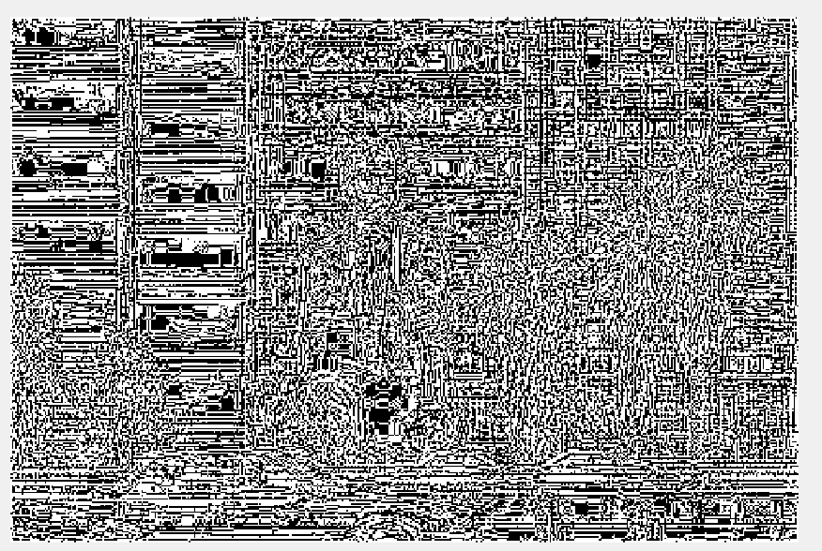
Example 3
default: 3x3, -0.2
Default Mean
Default median

Slide 34
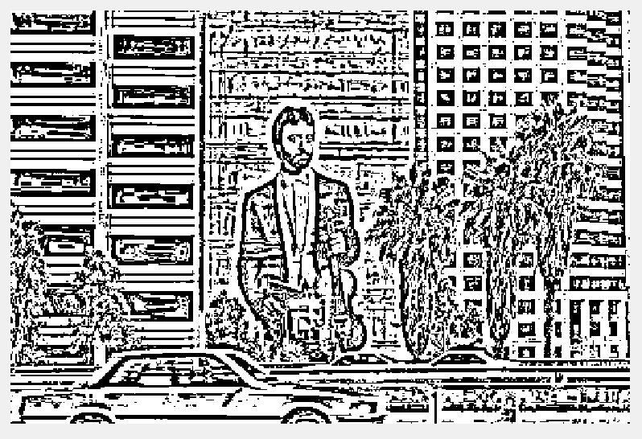
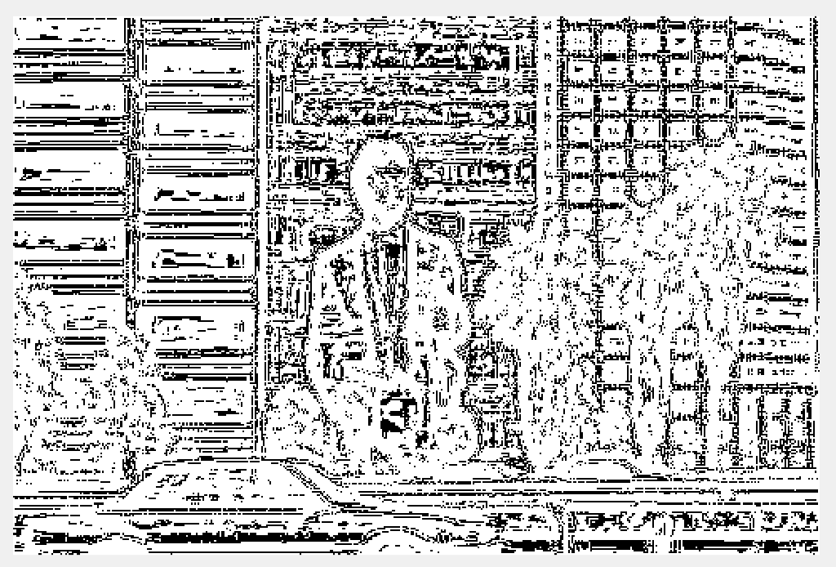
Example 3
“playing” for better results:
Mean: 9x9, -0.30
Median: 9x9, -0.90

Slide 35

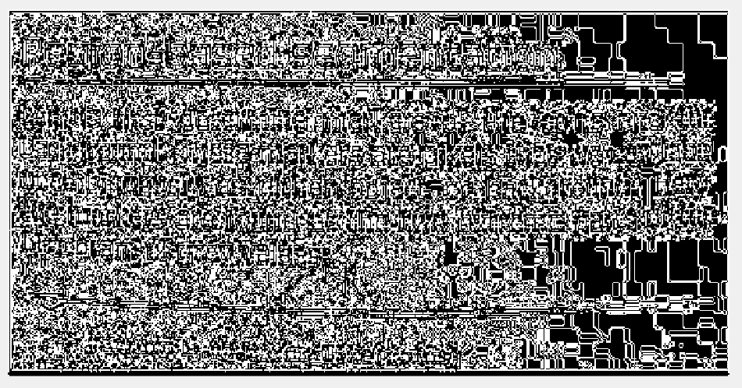
Example 4
default: 3x3, -0.2
Default Mean
Default median

Slide 36
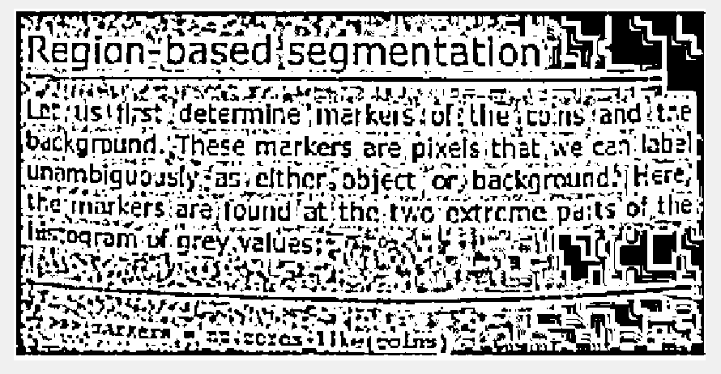
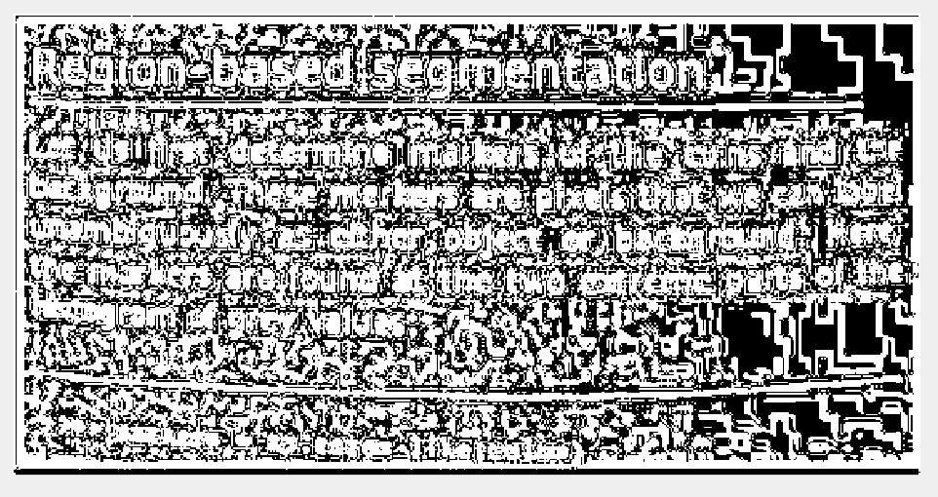
Example 4
“playing” for better results:
Mean: 9x9, -0.35
Median: 9x9, -0.80

Slide 37
Sauvola’s Locally Adaptive Thresholding
Window size, to split image into local windows
Threshold of local threshold based on local mean and standard deviation
Default constant “k” is suggested between 0.2-0.5
Does does better with variance in illumination
“k” used to control the effect of standard deviation
Following images done with MEAN and MEDIAN

Slide 38
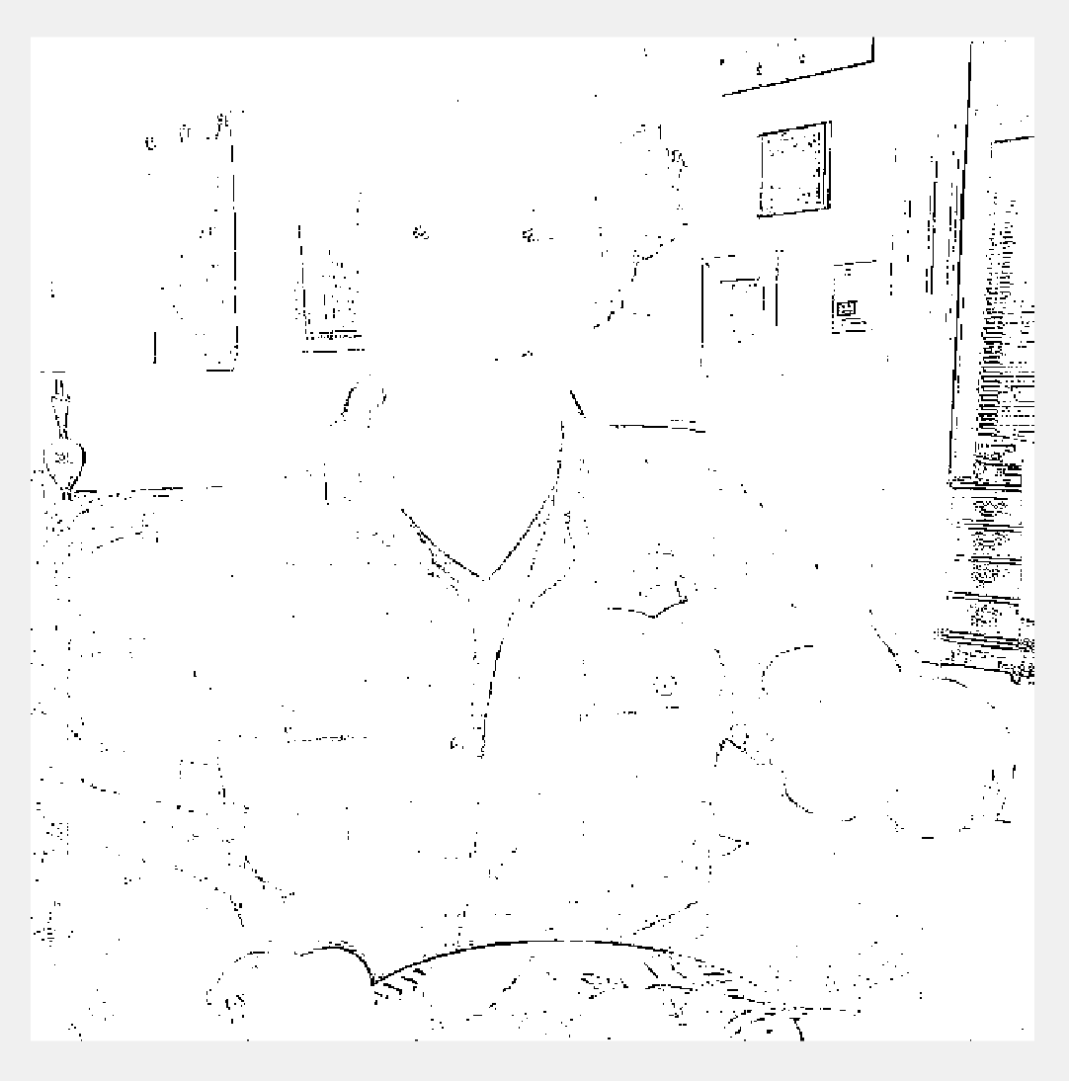

Example 1
default: 3x3, 0.34
Default Mean
Default median

Slide 39
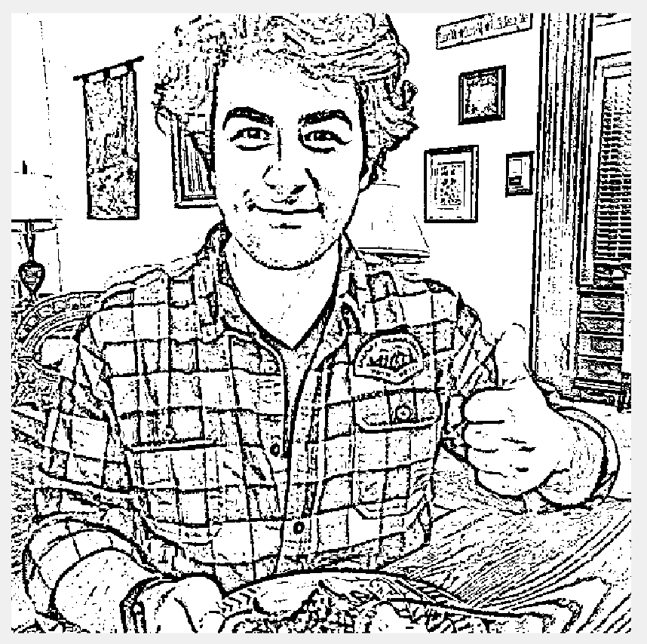
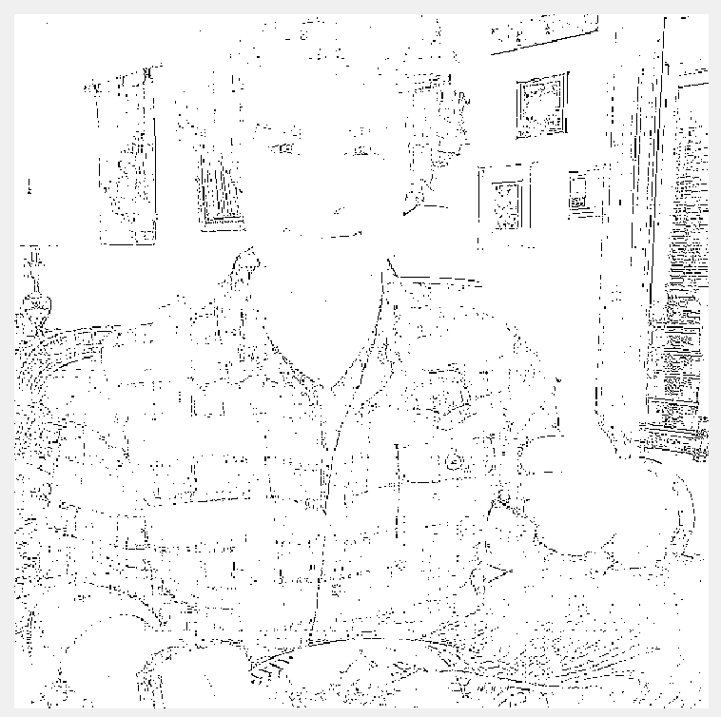
Example 1
“playing” for better results:
Mean: 10x10, 0.9
Median: 20x20, 0.15

Slide 40


example 2
default: 3x3, 0.34
Default Mean
Default median

Slide 41


example 2
“playing” for better results:
Mean: 5x5, 0.50
Median: 9x9, 0.50

Slide 42


example 3
default: 3x3, 0.34
Default Mean
Default median

Slide 43


example 3
“playing” for better results:
Mean: 7x7, 0.25
median: 5x5, 0.10

Slide 45


example 4
default: 3x3, 0.34
Default Mean
Default median

Slide 46


example 4
“playing” for better results:
Mean: 9x9, 0.30
median: 9x9, 0.30

Slide 47
thank you

